Slide 1
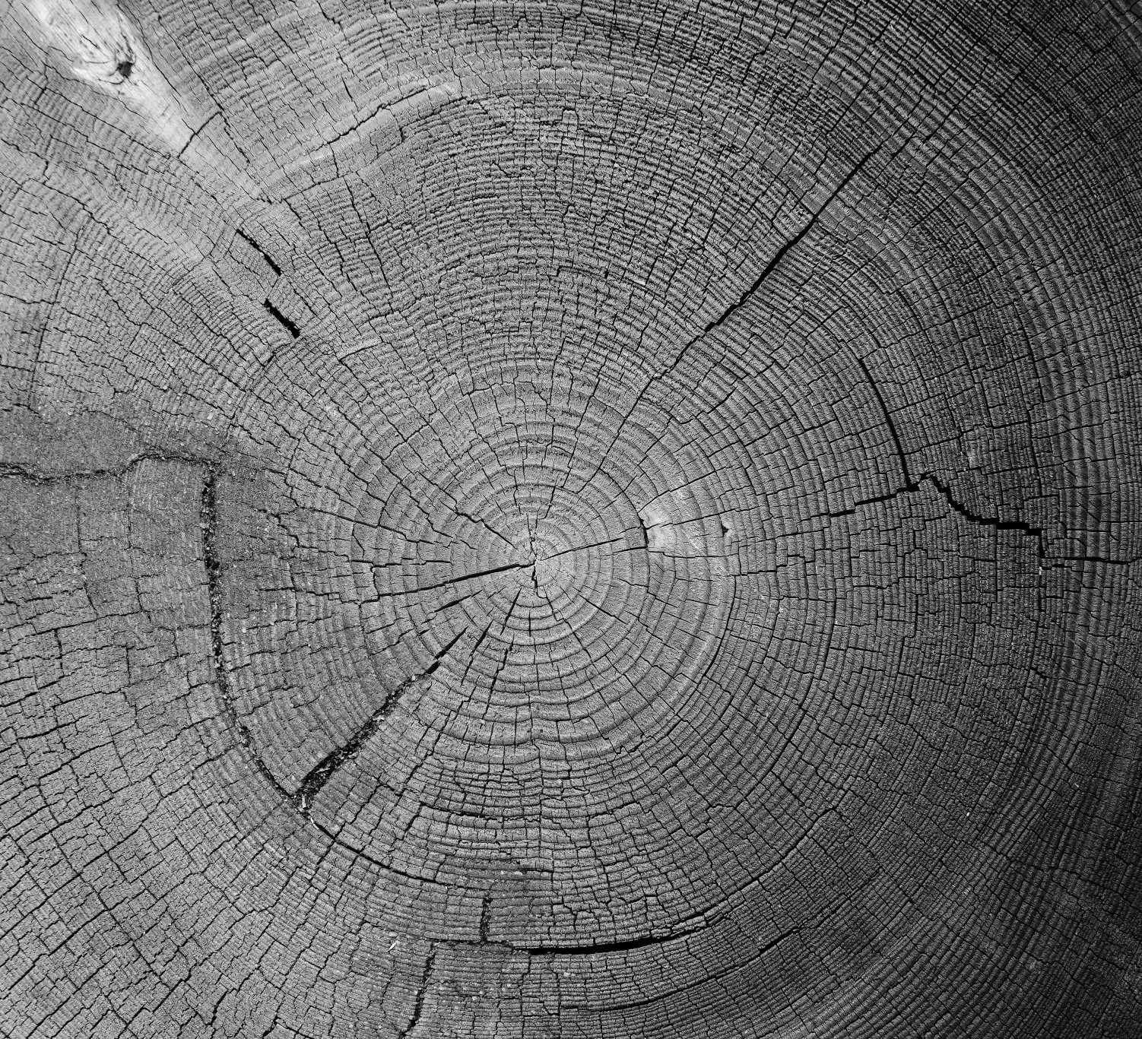
Convolution Neural Network to Detect Cracks in Pavement
Aalok Sharma Kafle

Slide 2

Objective
Train a Convolutional Neural Network (CNN) model to classify images of cracked and uncracked concrete

Slide 3
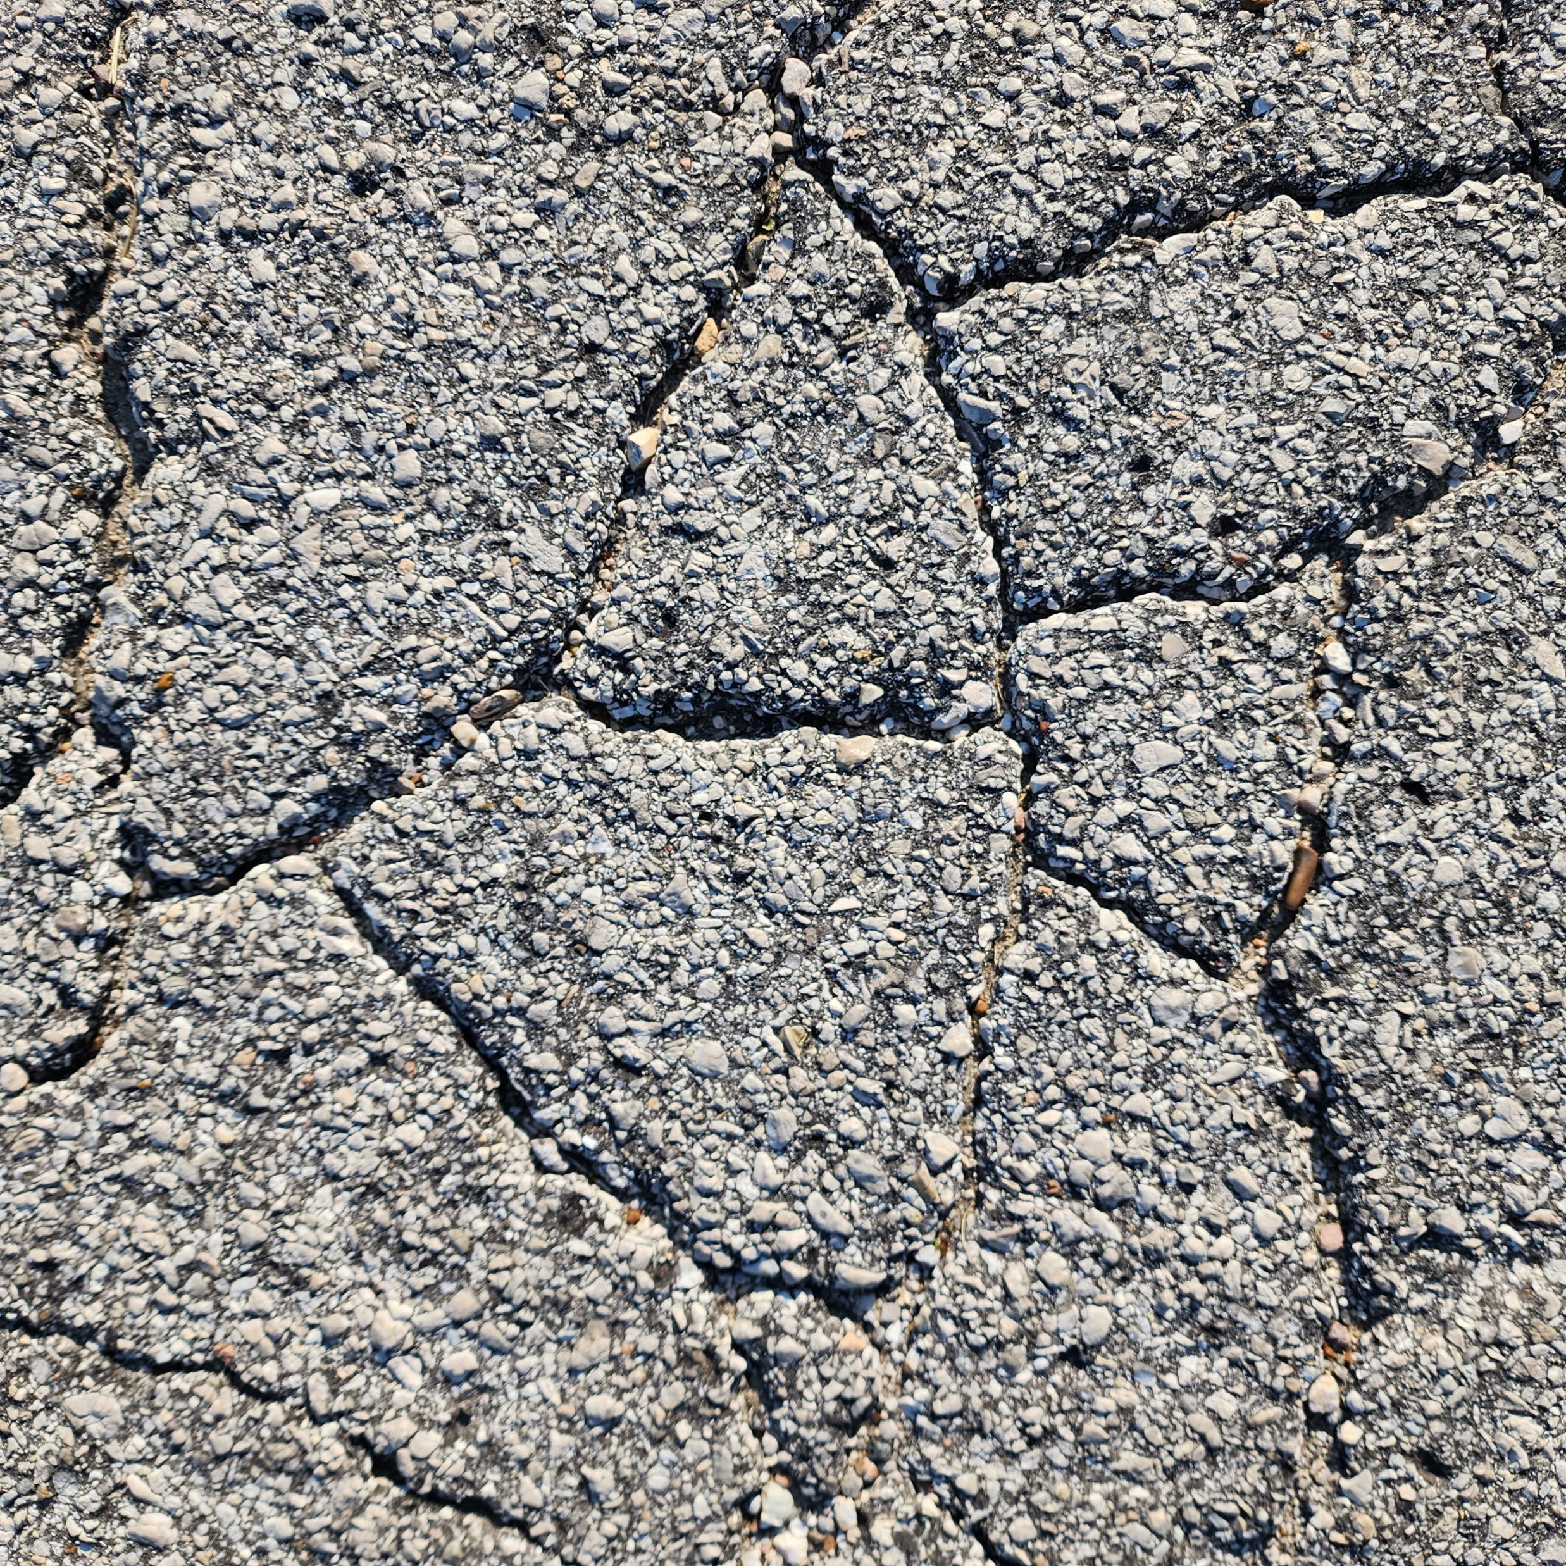
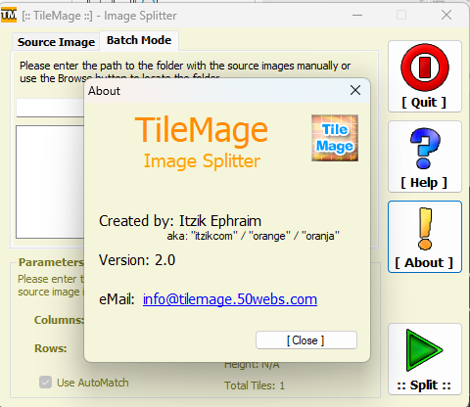
Data Preprocessing – Image Splitting

Slide 4
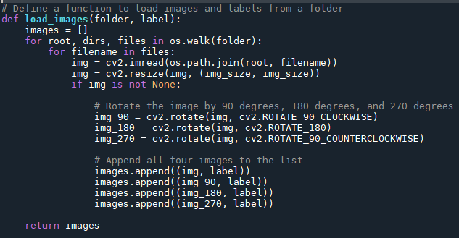
Data Preprocessing
Function to load Image
Using cv2 from opencv package
Append images with 90°, 180°, and 270° rotation.
All images of 256 X 256 size.

Slide 5
Data Preprocessing Summary
Total Number of Images = 14096
Intentionally equal number of images for cracked and uncracked class.
Cracked image images added with 90°, 180°, and 270° rotation.
Unracked image images added only with 180° rotation.
Test Train Split 80-20.

Slide 6
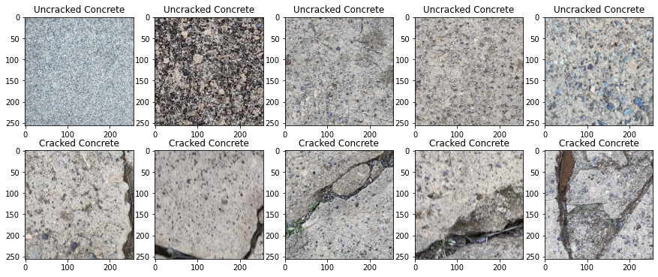
Looking at the data

Slide 7
Model Architecture
13 layers
9 - Three sets of convolutional, max pooling, and dropout layers
1 - A Flatten layer
1 - Fully connected Dense layer
1 - Final output layer
First layer is a convolutional layer
16 filters of size 3x3,
ReLU activation function,
Input shape of (256, 256, 3) representing a 256x256 RGB image.

Slide 8
Model Architecture
Second and third sets of layers have similar structures
32 filters of 3x3 size
ReLU activation Functions,
A max pooling layers of size 2x2,
Dropout layers with a dropout rate of 0.3.
Flatten layer -
Transform the output of the convolutional layers into a one-dimensional vector,

Slide 9
Model Architecture
Fully connected layers with 258.
First fully connected layer has a ReLU activation function,
Output fully connected layer with 1 neuron
Sigmoid activation function,
Probability output for the binary classification problem.
Model Compilation
Binary cross-entropy loss
Adam optimizer
Evaluation metric - Accuracy

Slide 10
Model Training
Batch Size – 64
Epoch – 10
Epoch | Run Time (seconds) | Loss | Accuracy
1/10 | 68 | 24.0147 | 0.5201
2/10 | 70 | 0.7028 | 0.5195
3/10 | 73 | 0.6931 | 0.5355
4/10 | 73 | 0.6314 | 0.6148
5/10 | 72 | 0.5419 | 0.7326
6/10 | 72 | 0.5054 | 0.7683
7/10 | 72 | 0.4680 | 0.7906
8/10 | 69 | 0.4457 | 0.8015
9/10 | 70 | 0.4284 | 0.8109
10/10 | 71 | 0.4104 | 0.8166

Slide 11
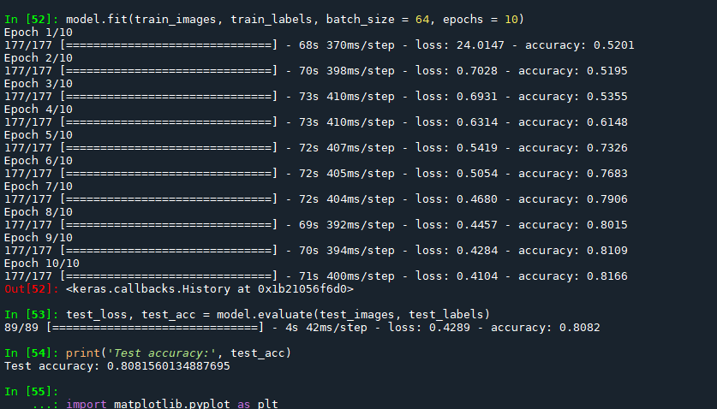

Slide 12
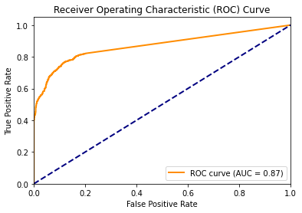
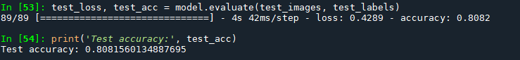
Model Results
Run Time (seconds) | Loss | Accuracy
4 | 0.4289 | 0.8082

Slide 13
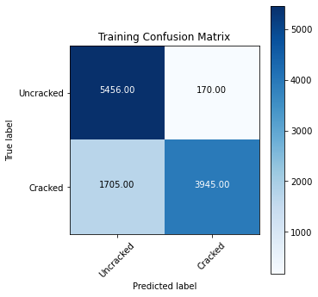

Model Results

Slide 14
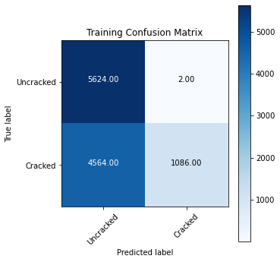
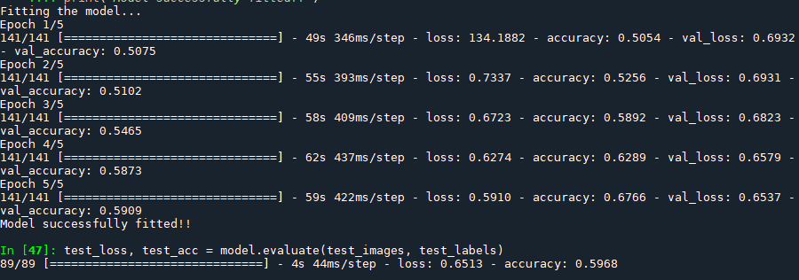
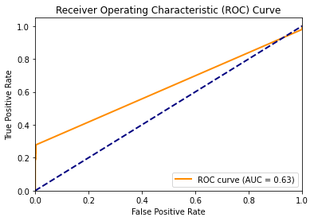

Results with 5 Epochs

Slide 15
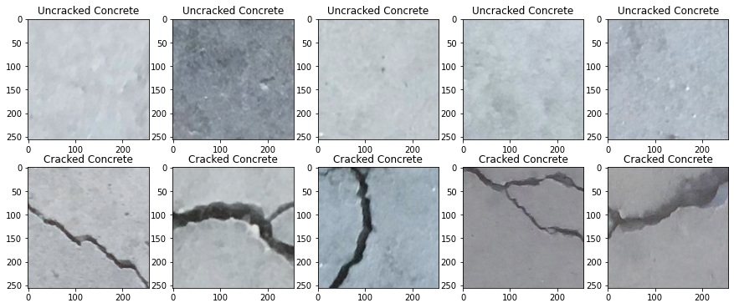
Running the Model on a bigger dataset
20000 cracked images
20000 uncracked images
Without random rotation or flipping
Özgenel, Çağlar Fırat (2019), “Concrete Crack Images for Classification”, Mendeley Data, V2, doi: 10.17632/5y9wdsg2zt.2

Slide 16
Model Summary
Same preprocessing.
160000 images split equally among two classes.
Same Model Architecture (with 5 epochs instead of 10).
Fit Summary:
Epoch | Run Time (seconds) | Loss | Accuracy
1/5 | 585 | 5.5179 | 0.8086
2/5 | 590 | 0.0660 | 0.9796
3/5 | 597 | 0.0515 | 0.9836
4/5 | 612 | 0.0664 | 0.9781
5/5 | 593 | 0.0440 | 0.9868

Slide 17
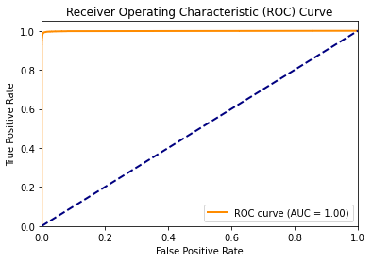
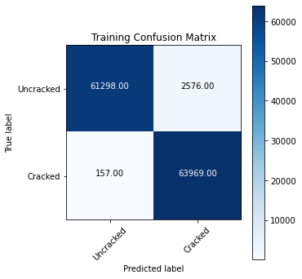
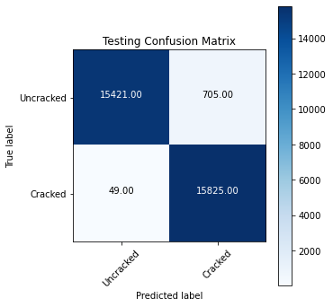
Model Results
Result Summary:
Run Time (seconds) | Loss | Accuracy
47 | 0.1999 | 0.9764

Slide 18
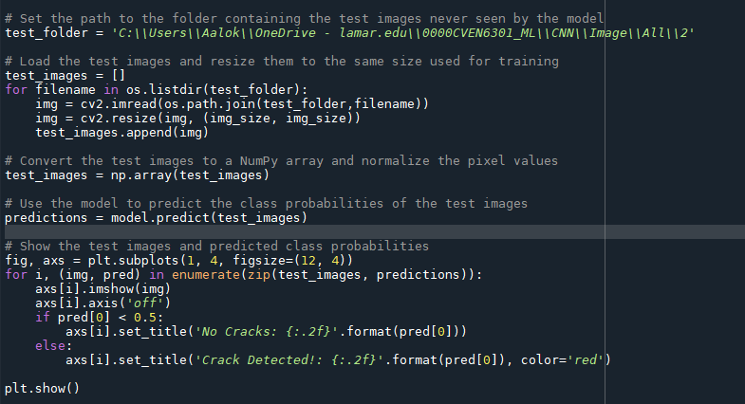
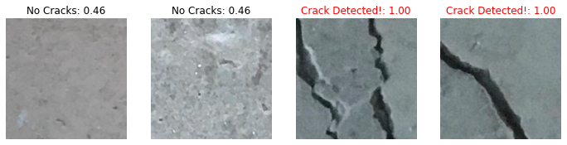
Using the model to predict new images

